Slide 1
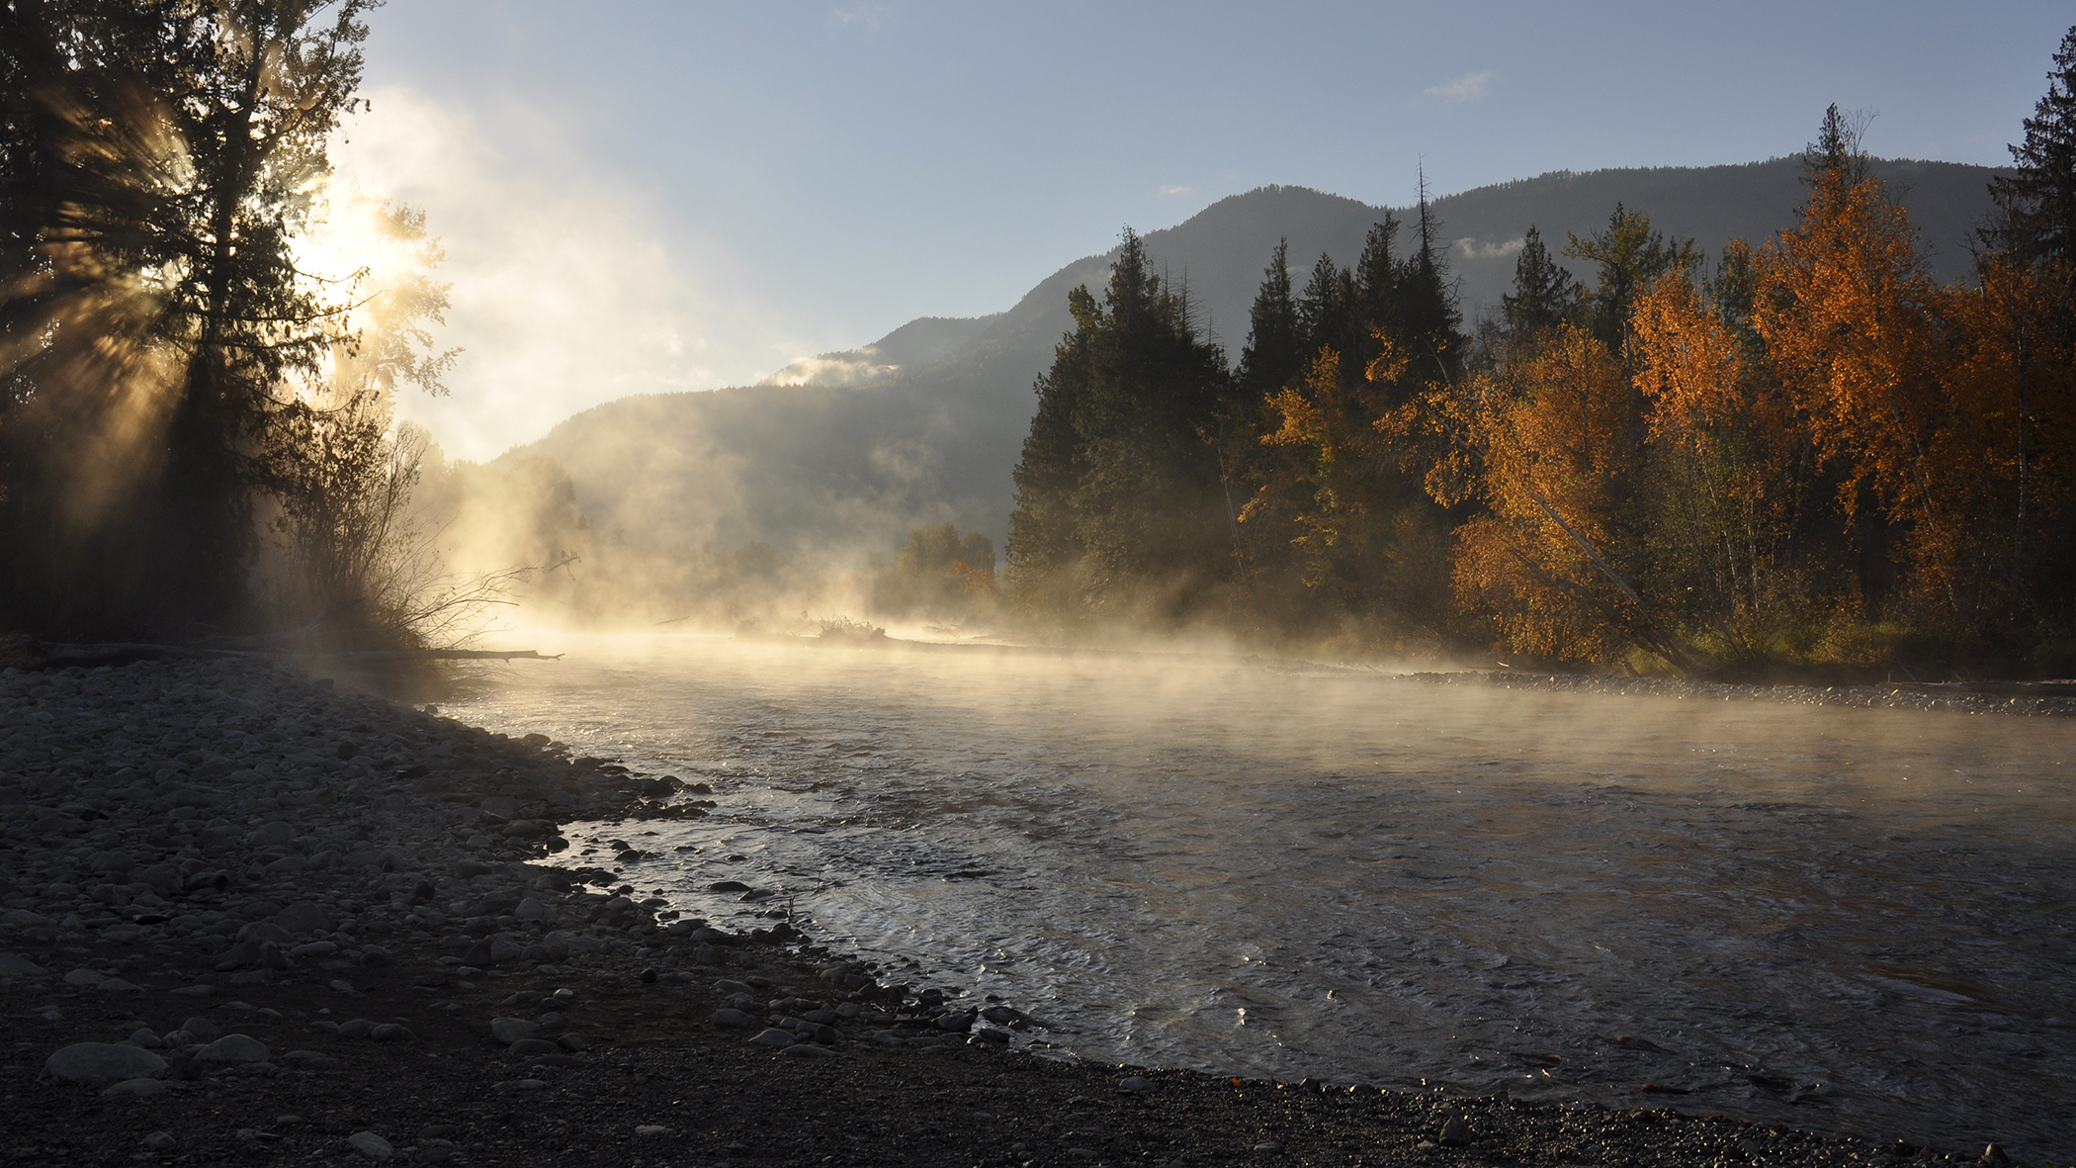
Preliminary 2025 Pacific Salmon Outlook

Slide 2
PRESENTATION OUTLINE
Introduction
Area Outlooks
Discussion
Conclusion
Fraser and Interior
North Coast
South Coast
Yukon Transboundary
Chinook
Chum
Coho
Sockeye
Pink
Chinook
Chum
Coho
Sockeye
Pink
Chinook
Chum
Coho
Sockeye
Pink
Chinook
Chum
Coho
Sockeye
Pink
Notes:
Category names may change e.g., Discussion/Conclusion
Adjust Sockeye Lake Type vs River Type
Specify Pink Even (vs odd)

Slide 3
INTRODUCTION
Purpose of the Outlook
Provide expected salmon abundance for 2026
Inform harvest planning and management decisions
Combine expert opinion and statistical forecast, where available

Slide 4
INTRODUCTION
Contributors
Stock assessment biologists across the Region
Collaborative programs with First Nations
Other stakeholders and stewardship groups

Slide 5
INTRODUCTION
How Outlooks Are Defined
By default, SMU scale
Apply the Precautionary Approach
If CU-level data available:
Use CU scale, apply Wild Salmon Policy benchmarks
For data-limited stocks:
Use SMU scale, rely on expert judgment

Slide 6
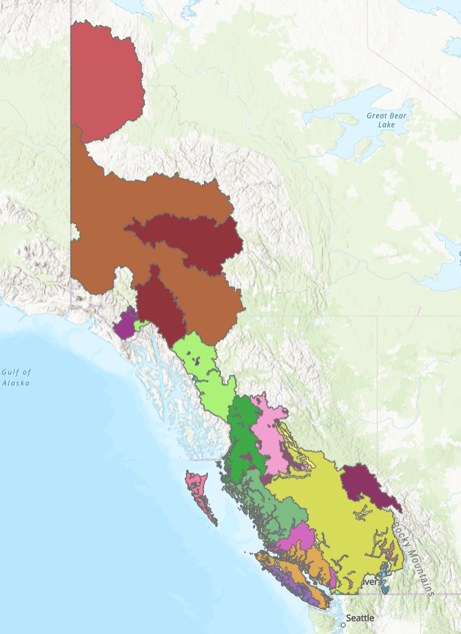
INTRODUCTION
Stock Management Units
What is an SMU?
A group of one or more Conservation Units (CUs) managed together
Harvest rules usually apply to the aggregate
Why use SMUs?
Practical grouping of CUs for harvest planning and reporting
Basis for Integrated Fisheries Management Plans (IFMPs)
Important Notes
CU-level diversity still considered
Precautionary Approach often applied within SMUs
SMUs for [sp.] salmon
Notes:
Need to update map. Maybe colour by Area. Change projection.

Slide 7
INTRODUCTION
Biological and Management References
Purpose of forecasts and outlooks
Inform harvest managers about expected stock abundance
Support adjustments to harvest plans
References points and targets
Biological benchmarks or limit reference points included when available
Management targets noted if in place
Current gap
Many stocks lack defined references
Work is ongoing to develop methods and analyses

Slide 8
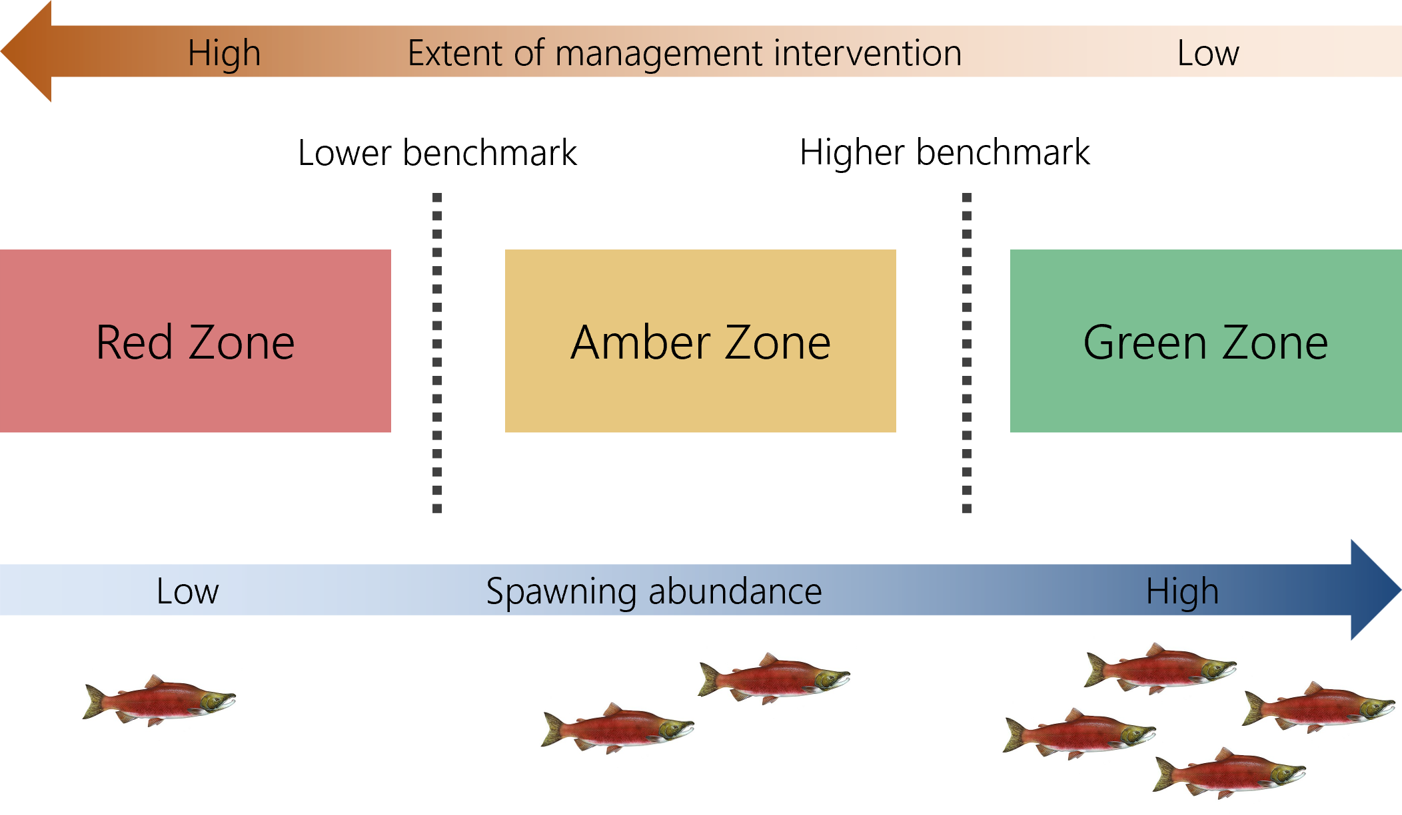
INTRODUCTION
Wild Salmon Policy Benchmarks
CU-level assessment under WSP
CUs are assessed against biological benchmarks
Benchmarks indicate significant changes in production status
Zones and management response
Red: Low abundance ➔ high intervention
Amber: Moderate abundance ➔ caution
Green: High abundance ➔ low intervention
Benchmarks and zones under the Wild Salmon Policy (DFO, 2005)

Slide 9
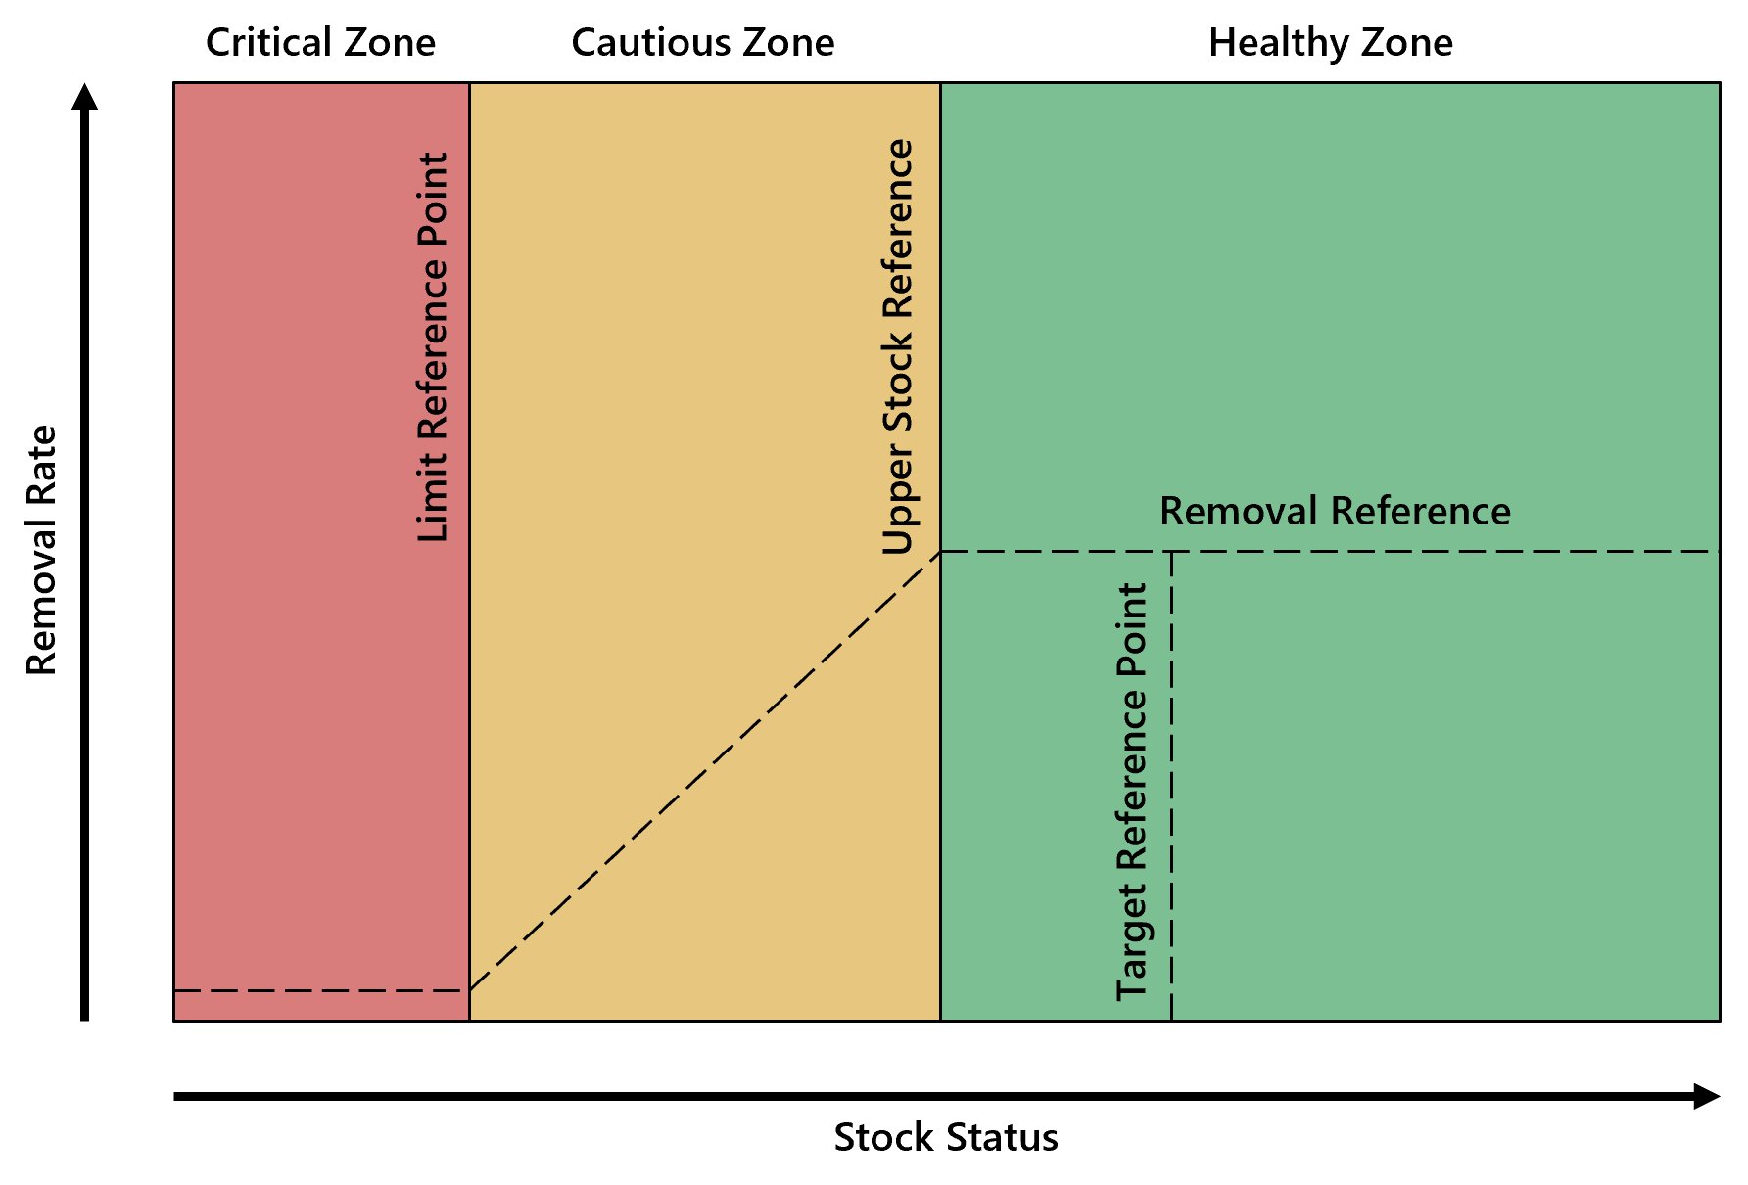
INTRODUCTION
Precautionary Approach
For SMUs: harvest decisions use reference points
Limit Reference Point (LRP) = critical harvest threshold
Below LRP ➔ major stock and ecosystem risk
Methods for defining LRPs vary by data availability
DFO’s precautionary principal
Notes:
Should color be removed? Keep that specific to WSP? Adjust to be more than just LRP

Slide 10
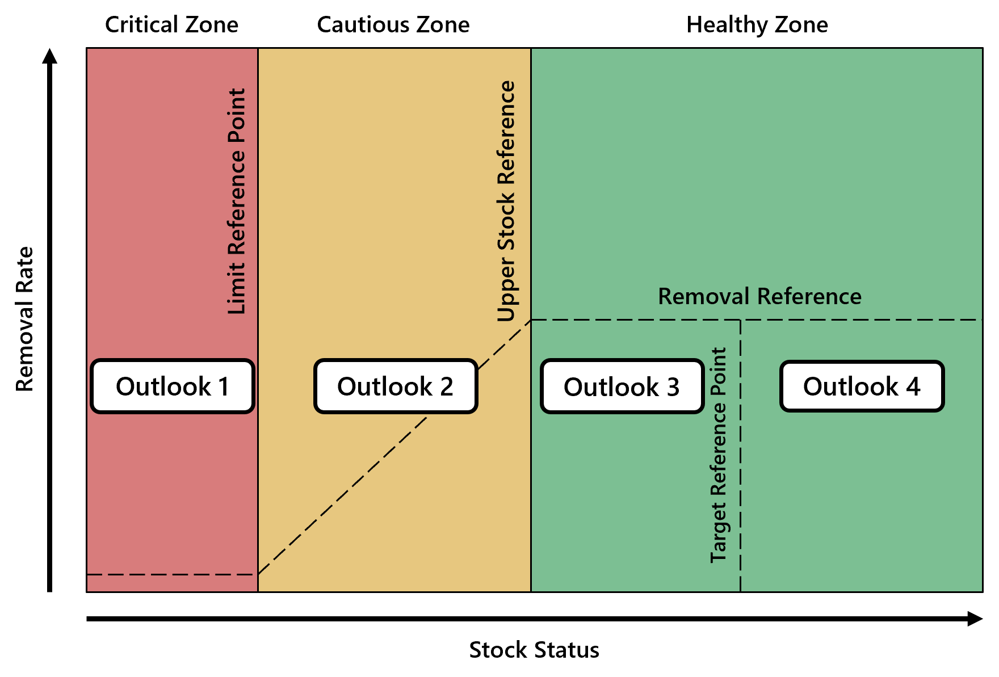
INTRODUCTION
Outlook Categories: Combining Approaches
Outlook Category | CUs or SMUs with references |  |  | Data-Limited CUs or SMUs
 | Wild Salmon Policy (CU Level) | Precautionary Approach (SMU Level) |  | Category Definition | Expected spawning abundance (percentile)
1 | Red Zone | Critical Zone |  | Well below average | <25
2 | Amber Zone | Cautious Zone |  | Below average | 25–40
3 | Green Zone | Healthy Zone |  | Near average | 40–60
4 | Green Zone | Healthy Zone |  | Abundant | >60
Data Deficient | - | - |  | Insufficient information | Unknown
Notes:
Need to show “1 to 2”, “2 to 3” etc?
Need labels for the WSP benchmarks??

Slide 11
CONCLUSION
Access Previous & Upcoming Outlooks
2024 Final Outlook
Pacific Salmon Outlook, Pacific Region 2024 (PDF)
2025 Final Outlook
Pacific Salmon Outlook, Pacific Region 2024 (PDF)
The final 2026 Outlook will be posted on the DFO Library once forecasts are completed
Notes:
How far back do these go???

Slide 12
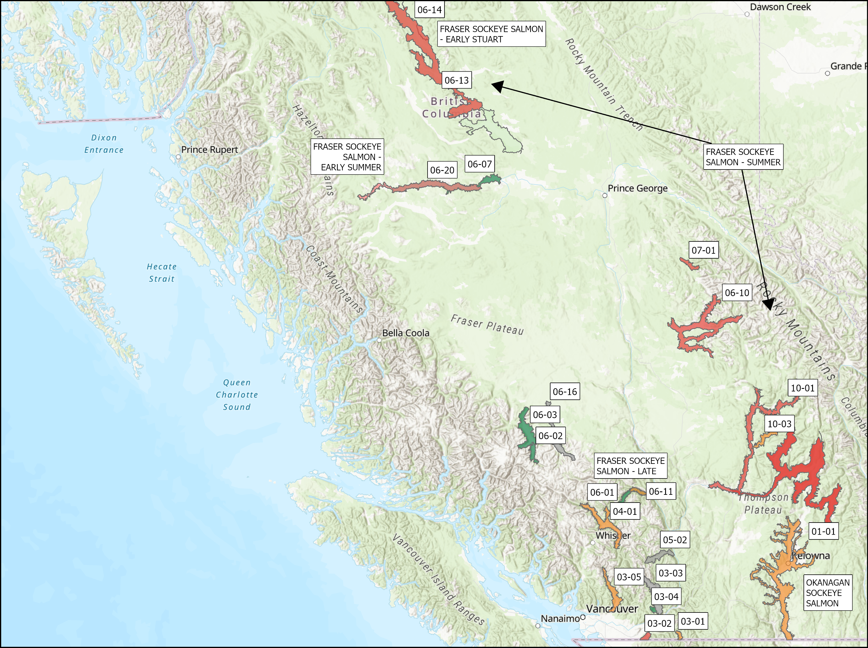
FRASER AND INTERIOR – SOCKEYE
SMU | CU / Subunit | Outlook
Fraser Sockeye Salmon -Early Stuart | Takla/ Trembleur-Early Stuart Timing | 1
Lower Fraser | CHILLIWACK-EARLY SUMMER TIMING | 1-4
Lower Fraser | PITT-EARLY SUMMER TIMING | 1-3
Lower Fraser | NAHATLATCH-EARLY SUMMER TIMING | NA
South Thompson | SHUSWAP-EARLY SUMMER TIMING (Seymour and Scotch) | 1
North Thompson | NORTH BARRIERE-EARLY SUMMER TIMING | 2
Mid and Upper Fraser | ANDERSON/SETON-EARLY SUMMER TIMING | 4
Mid and Upper Fraser | NADINA/FRANCOIS-EARLY SUMMER TIMING | 1-2
Mid and Upper Fraser | BOWRON-EARLY SUMMER TIMING | 1
Mid and Upper Fraser | TASEKO-EARLY SUMMER TIMING | NA
Fraser Sockeye Salmon - Summer | HARRISON RIVER | 1-2
Fraser Sockeye Salmon - Summer | QUESNEL-SUMMER TIMING | 1
Fraser Sockeye Salmon - Summer | RAFT RIVER/ KAMLOOPS-EARLY SUMMER TIMING | 1
Fraser Sockeye Salmon - Summer | STELLAKO /FRANCOIS/FRASER-SUMMER TIMING | 4
Fraser Sockeye Salmon - Summer | CHILKO-SUMMER TIMING and CHILKO ES | 4
Fraser Sockeye Salmon - Summer | LATE STUART/ TAKLA/TREMBLEUR/STUART-SUMMER TIMING | 3
Fraser Sockeye Salmon - Late | CULTUS-LATE TIMING | 1
Fraser Sockeye Salmon - Late | PORTAGE CREEK / SETON-LATE TIMING | 2
Fraser Sockeye Salmon - Late | SOUTH THOMPSON/ SHUSWAP COMPLEX-LATE TIMING | 1
Fraser Sockeye Salmon - Late | BIRKENHEAD / LILLOOET/HARRISON-LATE TIMING | 1-3
Fraser Sockeye Salmon - Late | WEAVER CREEK / HARRISON-UPSTREAM MIGRATING-LATE TIMING | 4
Fraser Sockeye Salmon - Late | BIG SILVER CREEK / HARRISON-DOWNSTREAM MIGRATING-LATE TIMING | NA
Fraser Sockeye Salmon - Late | WIDGEON CREEK | NA
Okanagan Sockeye | OSOYOOS | 2
Separate out Early Summer vs Summer etc.
Notes:
Expectations are for an average Somass Sockeye return in 2025, based on ocean indicators returns to date, and marine survival rates
Henderson: The 2024 adult return was low. The age composition data showed similar abundances of 42s and 52s. Expectations are for a below-average return.

Slide 13
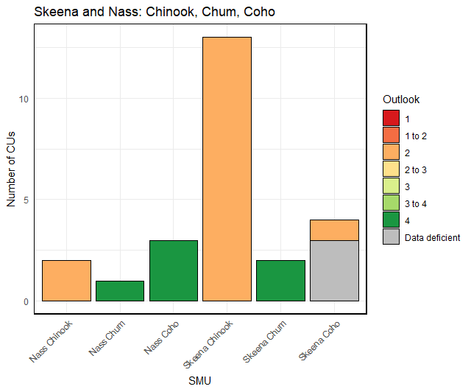
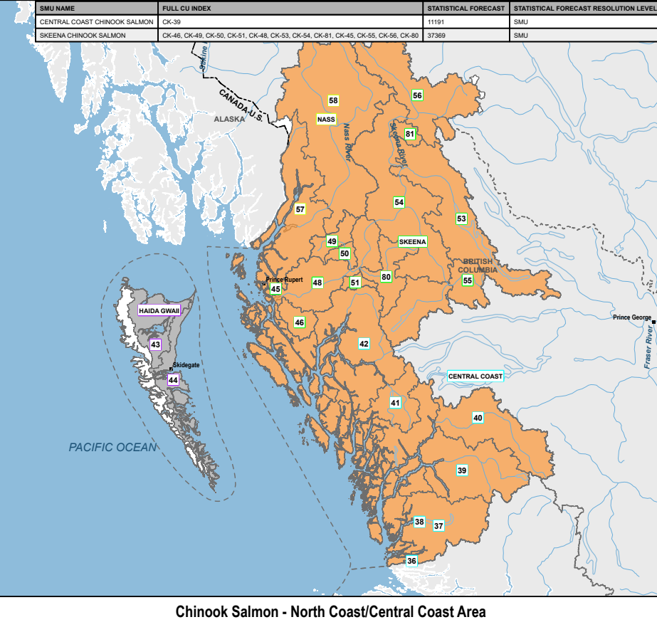
Skeena and Nass
Chinook, Chum, Coho
SMU | CU / Subunit | Outlook
Nass Chinook | Aggregate (2 CUs) | 2
Skeena Chinook | Aggregate (12 CUs) | 2
 | Kitsumkalum Indicator | 2
Nass Coho | Aggregate (3 CUs) | 4
Skeena Coho | Aggregate (3 CUs) | DD
 | Middle Skeena (1 CU) | 2
Nass Chum | Lower Nass (1 CU) | 4
Skeena Chum | Aggregate (2 CUs) | 4
Notes:
Expectations are for an average Somass Sockeye return in 2025, based on ocean indicators returns to date, and marine survival rates
Henderson: The 2024 adult return was low. The age composition data showed similar abundances of 42s and 52s. Expectations are for a below-average return.

Slide 14
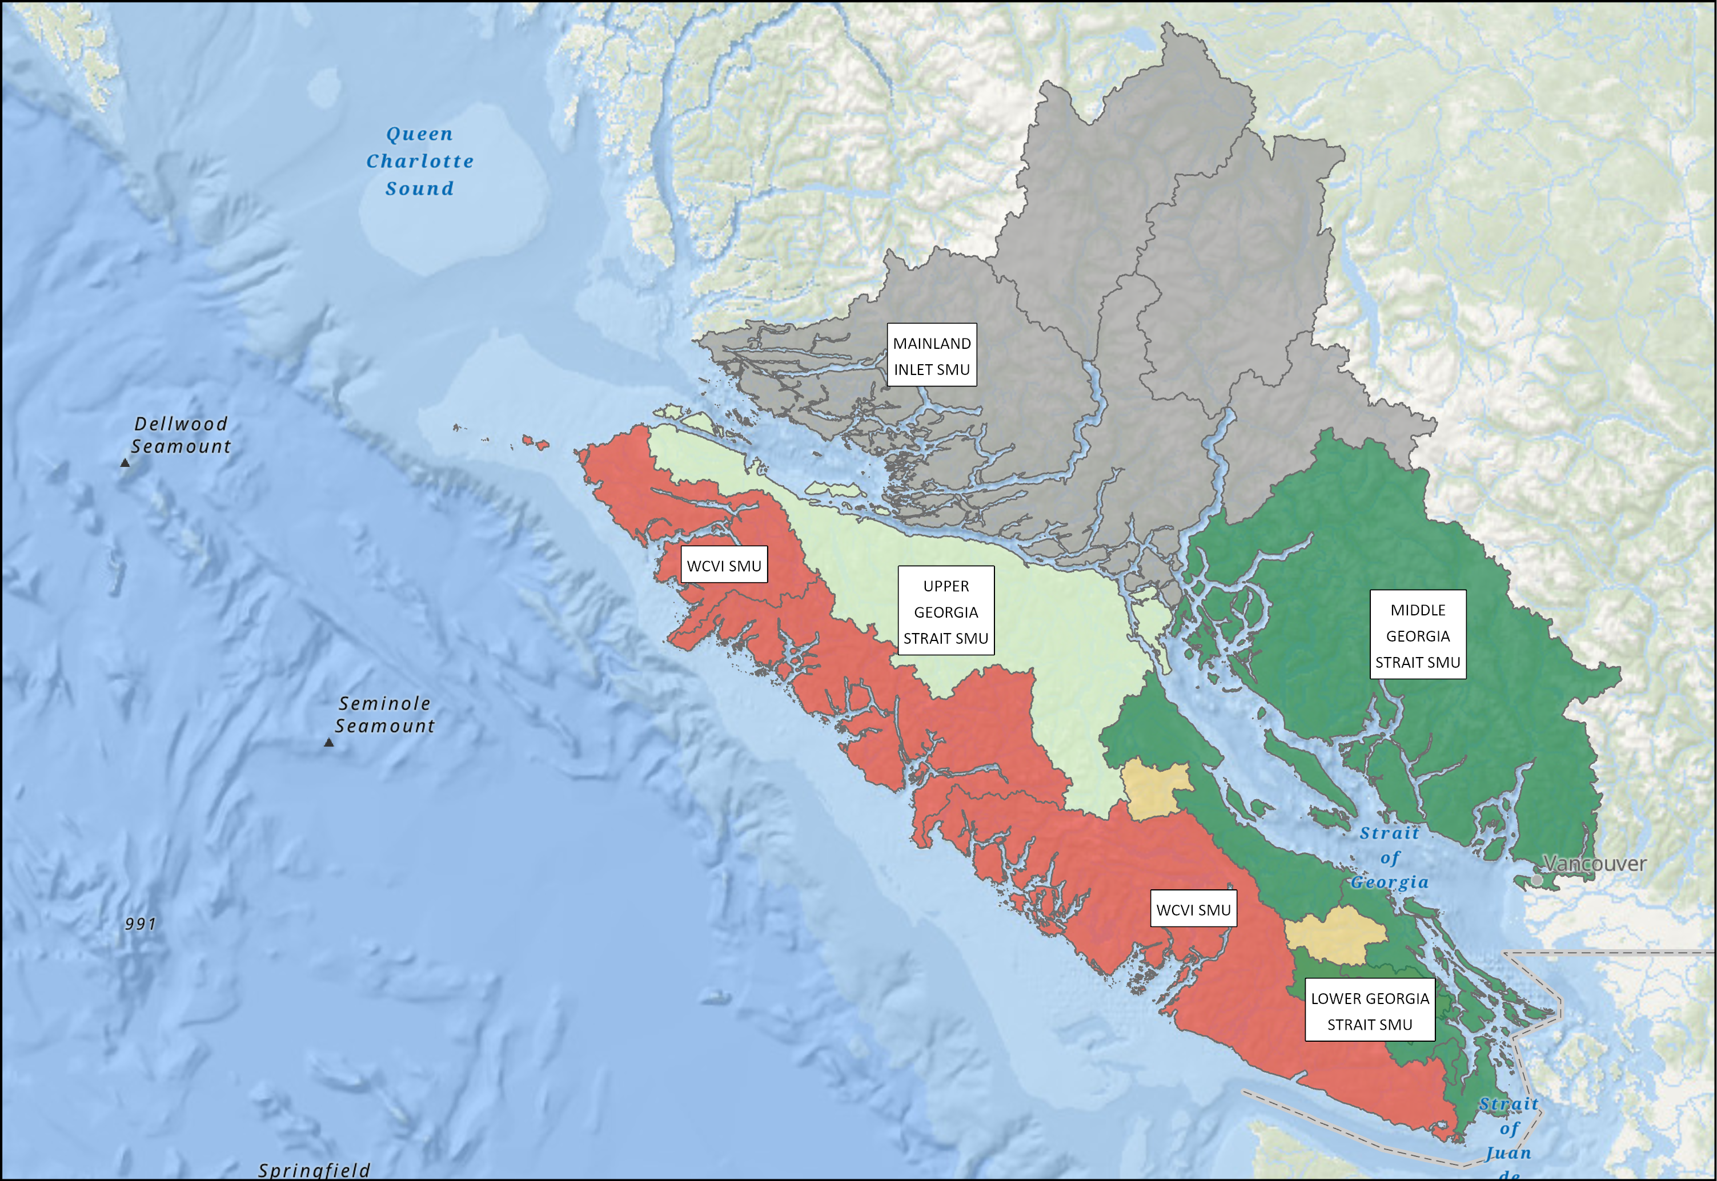
YUKON TRANSBOUNDARY - SOCKEYE
South Coast Area - Chinook
SMU | CU / Subunit | Outlook
Mainland Inlet | Aggregate (4 CUs) | DD
Upper Georgia Strait | Quinsam River Fall Run | 3
Middle Georgia Strait | Puntledge and Big Qualicum Rivers Fall Run Enhanced | 4
Middle Georgia Strait | Nanaimo and Puntledge Summer Enhanced | 1-2
Lower Georgia Strait | Cowichan River Fall Run Unenhanced | 4
West Coast Vancouver Island | Aggregate ( ?? CUs) | 2
Notes:
Expectations are for an average Somass Sockeye return in 2025, based on ocean indicators returns to date, and marine survival rates
Henderson: The 2024 adult return was low. The age composition data showed similar abundances of 42s and 52s. Expectations are for a below-average return.

Slide 15
2025 Preliminary Outlook Quick Reference
Yukon/Transboundary |  |  | North Coast/Central Coast |  |  |  |  | South Coast |  |  |  | Fraser River/BC Interior
Chinook |  |  | Chinook |  |  |  |  | Chinook |  |  |  | Chinook
ALSEK CHINOOK | 3 |  | CENTRAL COAST CHINOOK | 1 to 2 |  |  |  | LOWER GST CHINOOK | 4 |  |  | FRASER FALL RUN 41 CHINOOK | 3
PORCUPINE CHINOOK | 1 |  | HAIDA GWAII CHINOOK | DD |  |  |  | MAINLAND INLET CHINOOK | DD |  |  | FRASER SP RUN 42 CHINOOK | 1
STIKINE CHINOOK | 1 |  | NASS CHINOOK | 2 |  |  |  | MIDDLE GST CHINOOK | 2 to 3 | 4 |  | FRASER SP RUN 52 CHINOOK | 2
TAKU CHINOOK | 4 |  | SKEENA CHINOOK | 2 |  |  |  | UPPER GST CHINOOK | 3 |  |  | FRASER SU RUN 41 CHINOOK | 1 |  | 4
YUKON CHINOOK | 1 |  | Chum |  |  |  |  | WCVI CHINOOK | 1 | 4 |  | FRASER SU RUN 52 CHINOOK | 2
Chum |  |  | CENTRAL COAST CHUM | 1 | 2 | DD |  | Chum |  |  |  | OKANAGAN CHINOOK | 1
PORCUPINE CHUM | 1 to 2 |  | HAIDA GWAII CHUM | 1 to 2 |  |  |  | INNER SOUTH COAST CHUM | 2 to 3 |  |  | Chum
TRANSBOUNDARY CHUM | DD |  | SKEENA/NASS CHUM | 4 |  | DD |  | WCVI CHUM | 3 |  |  | FRASER CHUM | 2
YUKON CHUM | 1 to 2 |  | Coho |  |  |  |  | Coho |  |  |  | Coho
Coho |  |  | CENTRAL COAST COHO | 3 |  | DD |  | JST/MAINLAND INLET COHO | 2 |  |  | INTERIOR FRASER COHO | 2
ALSEK COHO | 3 |  | HAIDA GWAII COHO | DD |  |  |  | STRAIT OF GEORGIA COHO | 3 |  |  | LOWER FRASER COHO | Data Deficient
STIKINE COHO | DD |  | NASS COHO | 4 |  |  |  | WCVI COHO | 3 |  |  | Pink
TAKU COHO | 3 |  | SKEENA COHO | 2 |  | DD |  | Pink |  |  |  | FRASER PINK - ODD | 4
PORCUPINE COHO | DD |  | Pink |  |  |  |  | ECVI/MNLAND PINK- EVEN | N/A |  |  | Sockeye
Sockeye |  |  | CENTRAL COAST PINK | 2 | 3 | DD |  | ECVI/MNLAND PINK - ODD | 2 to 3 | 3 |  | FRASER SOCKEYE - ESTU | 1
ALSEK SOCKEYE | 3 |  | HAIDA GWAII PINK | DD |  |  |  | WCVI PINK | Data Deficient |  |  | FRASER SOCKEYE - ESUM | 1 | 2 | 4
STIKINE SOCKEYE | 2 to 3 |  | NASS PINK | 4 |  |  |  | Sockeye |  |  |  | FRASER SOCKEYE - LATE | 1 | 2 | 4
TAKU SOCKEYE | 4 |  | SKEENA PINK | 4 |  |  |  | ECVI/MAINLAND SOCKEYE | 1 | 2 |  | FRASER SOCKEYE - SUMMER | 1 | 3 | 4
 |  |  | Sockeye |  |  |  |  | WCVI - BARKLEY SOCKEYE | 2 | 3 |  | OKANAGAN SOCKEYE | 2
 |  |  | CENTRAL COAST SOCKEYE | DD |  |  |  | WCVI - OTHER SOCKEYE | Data Deficient
 |  |  | HAIDA GWAII SOCKEYE | 3 | DD
 |  |  | NASS SOCKEYE | 4
 |  |  | RIVERS/SMITH SOCKEYE | 1
 |  |  | SKEENA SOCKEYE | 4
4 bar charts by Area

Slide 16
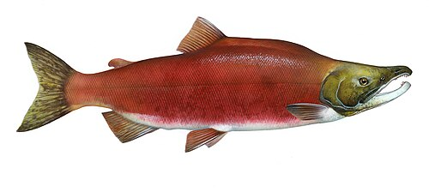
INTRODUCTION
FOR EDITING
High Extent of management intervention Low
Lower benchmark
Higher benchmark
Red Zone
Amber Zone
Green Zone
Low Spawning abundance High

Slide 17
INTRODUCTION
FOR EDITING
Critical Zone
Cautious Zone
Healthy Zone
Limit Reference Point
Upper Stock Reference
Removal Rate
Removal Reference
Outlook 1
Outlook 2
Outlook 3
Outlook 4
Target Reference Point
Stock Status

Slide 18
INTRODUCTION
Overview
The Salmon Outlook provides an estimate of expected abundance of salmon in 2025 to inform the harvest planning process.
This Outlook provides a categorical abundance expectation-based expert opinion as well as expected abundance for those stock units with statistical forecasts.

Slide 19
INTRODUCTION
Stock Management Units
A salmon ‘stock management unit’ (SMU) is a ‘group of one or more conservation units (CUs) that are managed together with the objective of achieving a joint status, meaning harvest control rules would apply to the aggregate in most cases.
Use of SMUs does not preclude considerations related to conserving CU-level diversity but rather is a practical aggregation of CUs for harvest planning and reporting purposes. It is the scale at which harvest management plans or management and assessment procedures, are developed in Integrated Fisheries Management Plans (IFMPs)
In many cases, elements of the Precautionary Approach are implemented at finer scales of organization within a SMU.

Slide 20
INTRODUCTION
Biological and Management References
The purpose of a stock forecast or outlook is to provide information to harvest managers to potentially adjust harvest plans according to the expected stock abundance.
Where biological benchmarks and/or limit reference points are defined for CUs or SMUs, they are noted in the final Outlook document. Similarly, if management targets are in place they are identified.
Lack of these references is a gap, and work is on-going to develop methods and complete the analyses to define these references.

Slide 21
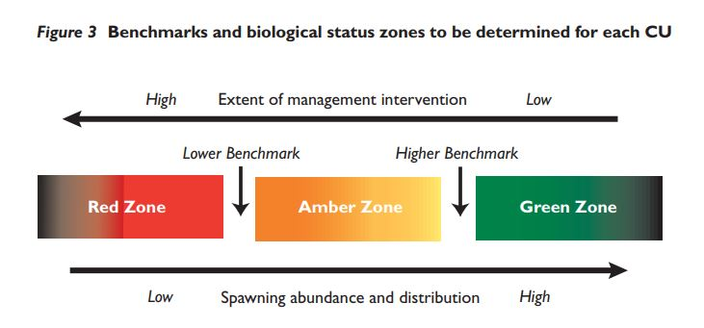
INTRODUCTION
For implementation of the Wild Salmon Policy, the status of salmon Conservation Units (CU) is assessed against ‘biological benchmarks’

Slide 22
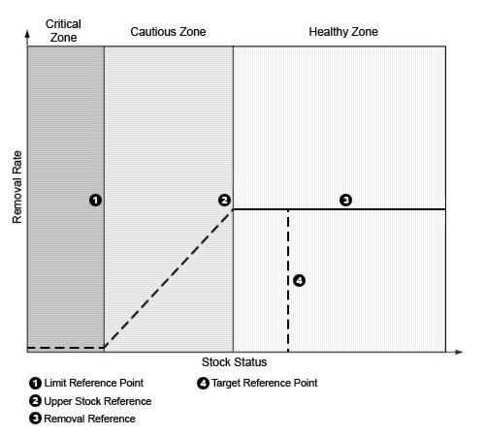
INTRODUCTION
DFO’s general ‘Precautionary Approach’
For harvest management:
Notes:
(PDF) Design of Ecological Risk Criteria for the integrated management of Canadian oceans
Maybe colour + label directly on the figure

Slide 23
INTRODUCTION
Outlook Categories
Outlook Category | CUs or SMUs with references |  | Data-Limited CUs or SMUs
 | Wild Salmon Policy (CU Level) | Precautionary Approach (SMU Level) | Category Definition | Expected spawning abundance
1 | Red Zone (below the LBB) | Critical Zone (below the LRP) | Well below average | <25th percentile
2 | Amber Zone (below the LBB, below the UBB) | Cautious Zone (above the LRP below the USR) | Below Average | 25 to 40th percentile
3 | Green Zone (above the UBB) | Healthy Zone (above the USR) | Near Average | 40 to 60th percentile
4 | Green Zone (at or above the TRP) | Healthy Zone (at or above the TRP) | Abundant | >60th percentile
Data Deficient | - | - | Insufficient information | Unknown

Slide 24
INTRODUCTION
Contributors
The Outlook document reflects the contribution and work of many stock assessment biologists across the region.
Much of the data and information used to create outlooks, status assessments and forecasts, are generated through collaborative programs involving First Nations, and other stakeholders and stewardship groups.
Notes:
Acknowledgments slide??

